Slide 1
Question -1 :
Your first priority is to get 2-3 players with high S.R who have faced at least 500 balls. And to do that you have to make a list of 10 players you want to bid in the auction so that when you try to grab them in auction you should not pay the amount greater than you have in the purse for a particular player.
batsman | num_balls | total_runs_scored | strike_rate
AD Russell | 832 | 1517 | 182.33
SP Narine | 543 | 892 | 164.27
HH Pandya | 847 | 1349 | 159.27
V Sehwag | 1755 | 2728 | 155.44
GJ Maxwell | 973 | 1505 | 154.68
RR Pant | 1368 | 2079 | 151.97
AB de Villiers | 3192 | 4849 | 151.91
CH Gayle | 3179 | 4772 | 150.11
KA Pollard | 2017 | 3023 | 149.88
JC Buttler | 1146 | 1714 | 149.56
WITH balls_faced AS ( SELECT batsman, COUNT(ball) AS num_balls FROM ipl_ball WHERE extras_type <> 'wides' GROUP BY batsman), runs_scored AS ( SELECT batsman, SUM(batsman_runs) AS total_runs_scored FROM ipl_ball GROUP BY batsman), combined_stats AS ( SELECT a.batsman, a.num_balls, b.total_runs_scored, ROUND((b.total_runs_scored * 100.0) / a.num_balls , 2) AS strike_rate FROM balls_faced a JOIN runs_scored b ON a.batsman = b.batsman WHERE a.num_balls > 500) SELECT * FROM combined_stats ORDER BY strike_rate DESC LIMIT 10;

Slide 2
Question -2 :
Now you need to get 2-3 players with good Average who have played more than 2 ipl seasons. And to do that you have to make a list of 10 players you want to bid in the auction so that when you try to grab them in auction you should not pay the mount
greater than you have in the purse for a particular player.
batsman | num_seasons | total_runs_scored | dismissals_count | batting_average
Iqbal Abdulla | 8 | 88 | 1 | 88.00
KL Rahul | 7 | 2647 | 62 | 42.69
AB de Villiers | 13 | 4849 | 114 | 42.54
DA Warner | 11 | 5254 | 126 | 41.70
JP Duminy | 8 | 2029 | 49 | 41.41
CH Gayle | 12 | 4772 | 116 | 41.14
ML Hayden | 3 | 1107 | 27 | 41.00
LMP Simmons | 4 | 1079 | 27 | 39.96
KS Williamson | 6 | 1619 | 41 | 39.49
OA Shah | 4 | 506 | 13 | 38.92
WITH seasons_played AS (SELECT batsman, COUNT(DISTINCT EXTRACT(YEAR FROM date)) as num_seasons FROM ipl_ball JOIN ipl_matches ON ipl_ball.id = ipl_matches.id GROUP BY batsman HAVING COUNT(DISTINCT EXTRACT(YEAR FROM date)) > 2),runs_scored AS (SELECT batsman, SUM(batsman_runs) AS total_runs_scored FROM ipl_ball GROUP BY batsman),dismissals AS (SELECT batsman, COUNT(*) AS dismissals_count FROM ipl_ball WHERE is_wicket = 1 GROUP BY batsman HAVING COUNT(*) > 0), combined_stats AS (SELECT a.batsman, a.num_seasons, b.total_runs_scored, c.dismissals_count,(b.total_runs_scored * 1.0) / c.dismissals_count AS batting_average FROM seasons_played a JOIN runs_scored b ON a.batsman = b.batsman JOIN dismissals c ON a.batsman = c.batsman) SELECT * FROM combined_stats ORDER BY batting_average DESC LIMIT 10;

Slide 3
Question -3:
Now you need to get 2-3 Hard-hitting players who have scored most runs in boundaries and have played more then 2 ipl season. To do that you have to make a list of 10 players you want to bid in the auction so that when you try to grab them in auction you should not pay the amount greater than you have in the purse for a particular player.
batsman | boundary_ percentage | seasons_ played | total_runs | boundary_ runs
SP Narine | 81% | 9 | 892 | 724
AD Russell | 79% | 8 | 1517 | 1194
CH Gayle | 76% | 12 | 4772 | 3630
CR Brathwaite | 75% | 4 | 181 | 136
ST Jayasuriya | 74% | 3 | 768 | 570
BCJ Cutting | 73% | 5 | 238 | 174
MJ McClenaghan | 73% | 5 | 85 | 62
AC Gilchrist | 73% | 6 | 2069 | 1508
Mujeeb Ur Rahman | 73% | 3 | 11 | 8
MS Gony | 73% | 6 | 99 | 72
SELECT b.batsman,
COUNT(DISTINCT EXTRACT(YEAR FROM m.date)) AS seasons_played, SUM(b.batsman_runs) AS total_runs,
SUM(CASE WHEN b.batsman_runs IN (4, 6) THEN b.batsman_runs ELSE 0 END) AS boundary_runs,
(SUM(CASE WHEN b.batsman_runs IN (4, 6) THEN b.batsman_runs ELSE 0 END) * 1.0 / SUM(b.batsman_runs)) AS boundary_percentage FROM IPL_Ball b JOIN IPL_Matches m ON b.id = m.id GROUP BY b.batsman HAVING COUNT(DISTINCT EXTRACT(YEAR FROM m.date)) > 2 AND SUM(b.batsman_runs) > 0 ORDER BY boundary_percentage DESC LIMIT 10;

Slide 4
Question - 4:
get 2-3 bowlers with good economy who have bowled at least 500 balls in IPL so far. To do that you have to make a list of 10 players you want to bid in the auction so that when you try to grab them in auction you should not pay the amount greater than you have in the purse for a particular player.
bowler | economy_rate | overs_bowled | runs_conceded
Harbhajan Singh | 7.04 | 573.33 | 4035
R Ashwin | 6.79 | 552 | 3750
PP Chawla | 7.92 | 546.17 | 4327
A Mishra | 7.28 | 537.33 | 3911
SL Malinga | 7.06 | 492.67 | 3477
DJ Bravo | 8.2 | 470.67 | 3860
SP Narine | 6.84 | 468 | 3201
B Kumar | 7.18 | 464.17 | 3331
RA Jadeja | 7.66 | 458.5 | 3512
P Kumar | 7.63 | 437.5 | 3339
SELECT b.bowler, ROUND (SUM(b.total_runs) / (COUNT(*) / 6.0),2) AS economy_rate,
ROUND(COUNT(*) / 6.0,2) AS overs_bowled, SUM(b.total_runs) AS runs_conceded
FROM IPL_Ball b
WHERE b.is_wicket = 0 OR b.dismissal_kind NOT IN ('run out', 'retired hurt', 'obstructing the field')
GROUP BY b.bowler
HAVING COUNT(*) >= 500
ORDER BY overs_bowled desc
LIMIT 10;

Slide 5
Question – 5:
get 2-3 bowlers with the best strike rate and who have bowled at least 500 balls in IPL so far. To do that you have to make a list of 10 players you want to bid in the auction so that when you try to grab them in auction you should not pay the amount greater than you have in the purse for a particular player.
bowler | balls_bowled | wickets_taken | bowling_strike_rate
K Rabada | 840 | 61 | 13.77
AJ Tye | 645 | 40 | 16.13
DE Bollinger | 600 | 37 | 16.22
Imran Tahir | 1314 | 80 | 16.43
SL Malinga | 2974 | 170 | 17.49
S Aravind | 788 | 45 | 17.51
MA Starc | 612 | 34 | 18.00
YS Chahal | 2188 | 121 | 18.08
KK Cooper | 600 | 33 | 18.18
TA Boult | 1152 | 63 | 18.29
SELECT b.bowler, COUNT(*) AS balls_bowled,
COUNT(CASE WHEN b.is_wicket = 1 AND b.dismissal_kind NOT IN ('run out', 'retired hurt', 'obstructing the field') THEN 1 END)
AS wickets_taken,
COUNT(*) * 1.0 / NULLIF(COUNT(CASE WHEN b.is_wicket = 1 AND
b.dismissal_kind NOT IN ('run out', 'retired hurt', 'obstructing the field') THEN 1 END), 2) AS bowling_strike_rate
FROM IPL_Ball b
GROUP BY b.bowler
HAVING COUNT(*) >= 500
ORDER BY bowling_strike_rate
LIMIT 10;

Slide 6
Question – 6:
get 2-3 All_rounders with the best batting as well as bowling strike rate and who have faced at least 500 balls in IPL so far and have bowled minimum 300 balls. To do that you have to make a list of 10 players you want to bid in the auction so that when you try to grab them in auction you should not pay the amount greater than you have in the purse for a particular player.
batsman | balls_faced | runs_scored | batting_strike_rate | balls_bowled | wickets_taken | bowling_strike_rate
SK Raina | 4041 | 5368 | 132.84 | 930 | 25 | 37.20
RG Sharma | 4088 | 5230 | 127.94 | 342 | 15 | 22.80
CH Gayle | 3342 | 4772 | 142.79 | 584 | 18 | 32.44
SR Watson | 2888 | 3874 | 134.14 | 2137 | 92 | 23.23
YK Pathan | 2330 | 3204 | 137.51 | 1184 | 42 | 28.19
KA Pollard | 2107 | 3023 | 143.47 | 1414 | 60 | 23.57
Yuvraj Singh | 2205 | 2750 | 124.72 | 882 | 36 | 24.50
JH Kallis | 2291 | 2427 | 105.94 | 1799 | 65 | 27.68
DR Smith | 1803 | 2385 | 132.28 | 557 | 26 | 21.42
RA Jadeja | 1774 | 2159 | 121.70 | 2759 | 114 | 24.20
WITH BattingStats AS (SELECT batsman,COUNT(*) AS balls_faced, SUM(batsman_runs) AS runs_scored, (SUM(batsman_runs) * 1.0 / COUNT(*)) * 100 AS batting_strike_rate FROM IPL_Ball GROUP BY batsman HAVING COUNT(*) >= 500),BowlingStats AS (SELECT bowler,COUNT(*) AS balls_bowled,COUNT(CASE WHEN is_wicket = 1 AND dismissal_kind NOT IN ('run out', 'retired hurt', 'obstructing the field') THEN 1 END) AS wickets_taken,(COUNT(*) * 1.0 / NULLIF(COUNT(CASE WHEN is_wicket = 1 AND dismissal_kind NOT IN ('run out', 'retired hurt', 'obstructing the field') THEN 1 END), 0)) AS bowling_strike_rate FROM IPL_Ball GROUP BY bowler HAVING COUNT(*) >= 300) SELECT b.batsman,b.balls_faced,b.runs_scored,b.batting_strike_rate,bo.balls_bowled,bo.wickets_taken,bo.bowling_strike_rateFROM BattingStats b JOIN BowlingStats bo ON b.batsman = bo.bowler ORDER BY runs_scored DESC ,(b.batting_strike_rate + bo.bowling_strike_rate) DESC LIMIT 10;

Slide 7
10 Additional Question

Slide 8
Question – 1 :
Get the count of cities that have hosted an IPL match
city_count
33
SELECT COUNT(DISTINCT city) AS city_count
FROM ipl_matches;

Slide 9
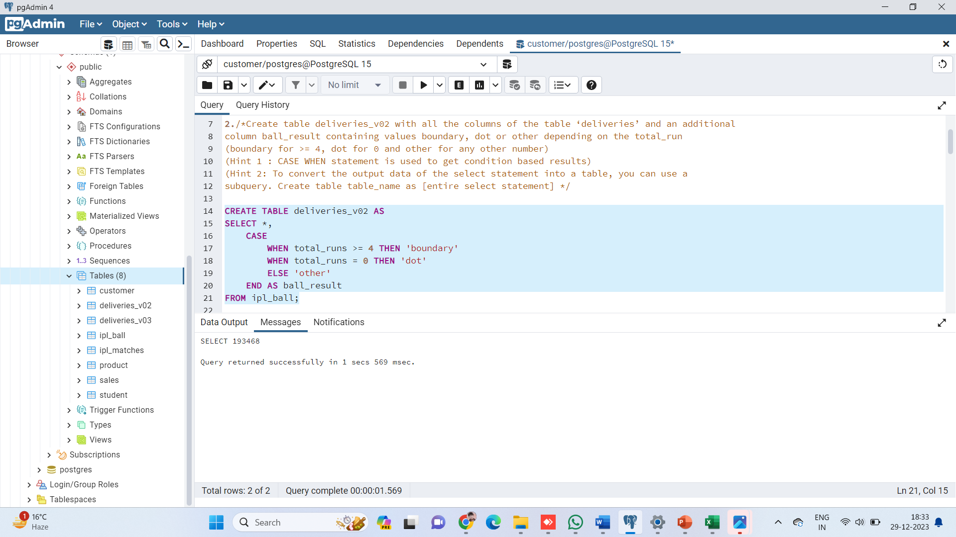
Question – 2 :
Create table deliveries_v02 with all the columns of the table ‘deliveries’ and an additionalcolumn ball_result containing values boundary, dot or other depending on the total_run(boundary for >= 4, dot for 0 and other for any other number)(Hint 1 : CASE WHEN statement is used to get condition based results)(Hint 2: To convert the output data of the select statement into a table, you can use asubquery. Create table table_name as [entire select statement]
CREATE TABLE deliveries_v02 ASSELECT *,
CASE WHEN total_runs >= 4 THEN 'boundary' WHEN total_runs = 0 THEN 'dot' ELSE 'other' END AS ball_resultFROM ipl_ball;

Slide 10
Question – 3 :
Write a query to fetch the total number of boundaries and dot balls from thedeliveries_v02 table.
ball_result | ball_count
boundary | 31468
dot | 67841
SELECT ball_result,COUNT(*) AS ball_countFROM deliveries_v02WHERE ball_result IN ('boundary', 'dot')GROUP BY ball_result;

Slide 11
Question – 4 :
Write a query to fetch the total number of boundaries scored by each team from the deliveries_v02 table and order it in descending order of the number of boundaries scored.
SELECt batting_team,
COUNT(*) AS boundary_count
FROM deliveries_v02
WHERE ball_result = 'boundary'
GROUP BY batting_team
ORDER BY boundary_count DESC;
batting_team | boundary_count
Mumbai Indians | 4118
Royal Challengers Bangalore | 3800
Kings XI Punjab | 3780
Kolkata Knight Riders | 3739
Chennai Super Kings | 3496
Rajasthan Royals | 3041
Delhi Daredevils | 3022
Sunrisers Hyderabad | 2306
Deccan Chargers | 1387
Pune Warriors | 733
Delhi Capitals | 659
Gujarat Lions | 624
Rising Pune Supergiant | 290
Rising Pune Supergiants | 242
Kochi Tuskers Kerala | 231

Slide 12
SELECT bowling_team,
COUNT(*) AS dot_ball_count
FROM deliveries_v02
WHERE ball_result = 'dot'
GROUP BY bowling_team
ORDER BY dot_ball_count DESC;
Question – 5 :
Write a query to fetch the total number of dot balls bowled by each team and order it in descending order of the total number of dot balls bowled.
bowling_team | dot_ball_count
Mumbai Indians | 8714
Royal Challengers Bangalore | 7955
Kolkata Knight Riders | 7894
Kings XI Punjab | 7679
Chennai Super Kings | 7593
Rajasthan Royals | 6665
Delhi Daredevils | 6520
Sunrisers Hyderabad | 5248
Deccan Chargers | 3306
Pune Warriors | 1900
Delhi Capitals | 1338
Gujarat Lions | 1095
Rising Pune Supergiant | 698
Kochi Tuskers Kerala | 626
Rising Pune Supergiants | 539

Slide 13
Question – 6 :
Write a query to fetch the total number of dismissals by dismissal kinds where dismissal kind is not NA
SELECT dismissal_kind,
COUNT(*) AS dismissal_count
FROM deliveries_v02
WHERE dismissal_kind IS NOT NULL AND dismissal_kind != 'NA'
GROUP BY dismissal_kind
ORDER BY dismissal_count DESC;
dismissal_kind | dismissal_count
caught | 5743
bowled | 1700
run out | 893
lbw | 571
stumped | 294
caught and bowled | 269
hit wicket | 12
retired hurt | 11
obstructing the field | 2

Slide 14
Question – 7 :
Write a query to get the top 5 bowlers who conceded maximum extra runs from the deliveries table
SELECT bowler,
SUM(extra_runs) AS total_extra_runs
FROM deliveries_v02
WHERE extra_runs > 0
GROUP BY bowler
ORDER BY total_extra_runs DESC
LIMIT 5;
bowler | total_extra_runs
SL Malinga | 293
P Kumar | 236
UT Yadav | 226
DJ Bravo | 210
B Kumar | 201

Slide 15
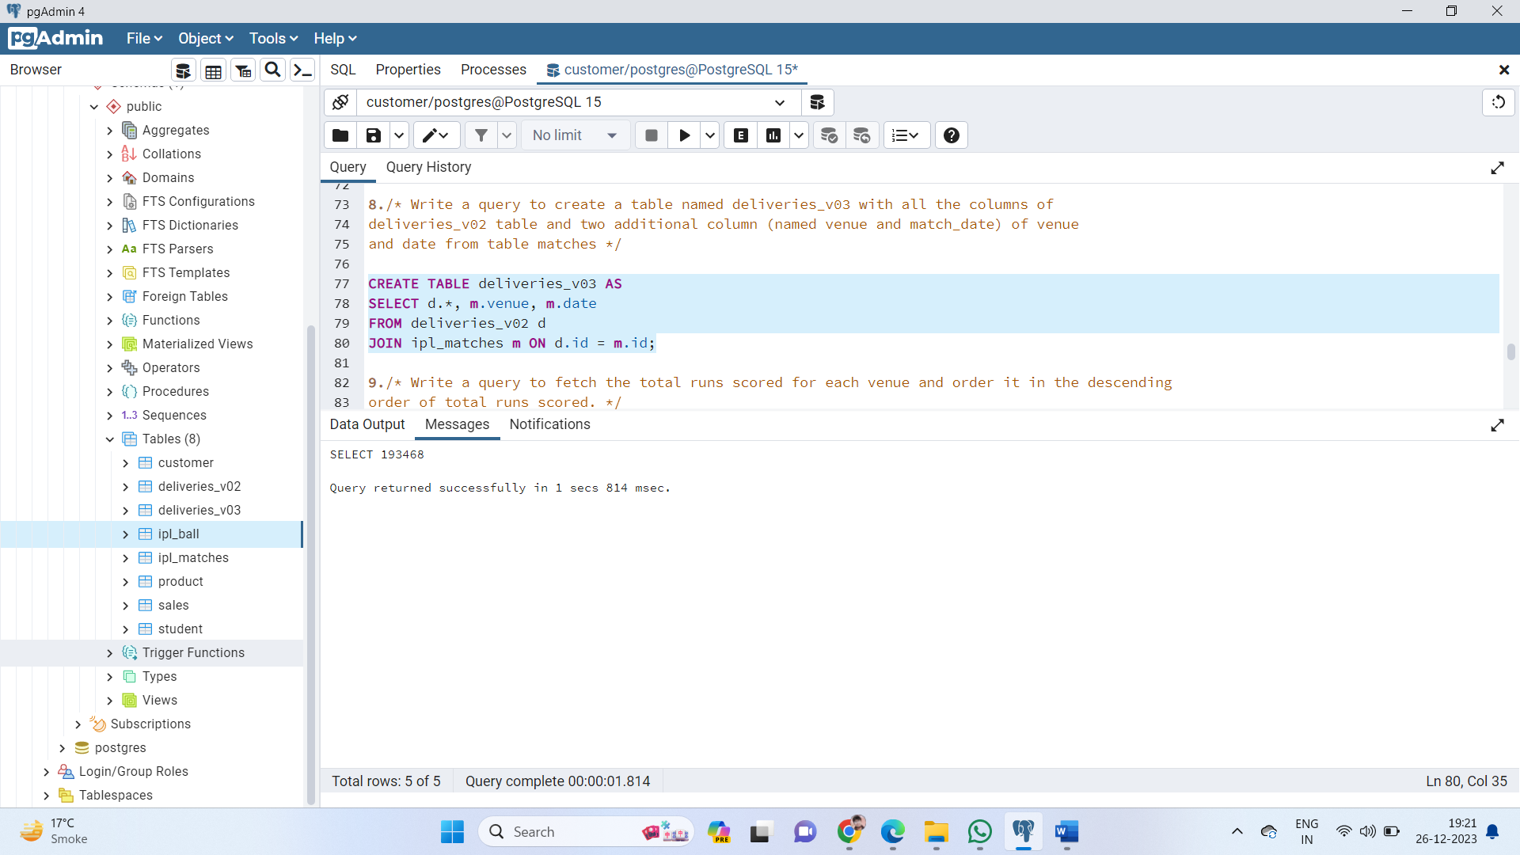
Question – 8 :
Write a query to create a table named deliveries_v03 with all the columns of deliveries_v02 table and two additional column (named venue and match_date) of venue and date from table matches
CREATE TABLE deliveries_v03 AS
SELECT d.*, m.venue, m.date
FROM deliveries_v02 d
JOIN ipl_matches m ON d.id = m.id;

Slide 16
Question – 9 :
Write a query to fetch the total runs scored for each venue and order it in the descending order of total runs scored.
venue | total_runs_scored
Eden Gardens | 23658
Wankhede Stadium | 23390
Feroz Shah Kotla | 22947
M Chinnaswamy Stadium | 20237
Rajiv Gandhi International Stadium, Uppal | 19484
MA Chidambaram Stadium, Chepauk | 17821
Sawai Mansingh Stadium | 14264
Punjab Cricket Association Stadium, Mohali | 10987
Dubai International Cricket Stadium | 10402
Sheikh Zayed Stadium | 8830
Punjab Cricket Association IS Bindra Stadium, Mohali | 7021
Maharashtra Cricket Association Stadium | 6780
Sharjah Cricket Stadium | 5924
M.Chinnaswamy Stadium | 5127
Dr DY Patil Sports Academy | 4810
Subrata Roy Sahara Stadium | 4755
Kingsmead | 4353
Brabourne Stadium | 3842
Sardar Patel Stadium, Motera | 3746
Dr. Y.S. Rajasekhara Reddy ACA-VDCA Cricket Stadium | 3746
SuperSport Park | 3653
Saurashtra Cricket Association Stadium | 3316
Himachal Pradesh Cricket Association Stadium | 2897
Holkar Cricket Stadium | 2872
New Wanderers Stadium | 2292
Barabati Stadium | 2278
JSCA International Stadium Complex | 2056
St George's Park | 2033
Newlands | 1764
Shaheed Veer Narayan Singh International Stadium | 1741
Nehru Stadium | 1363
Green Park | 1298
De Beers Diamond Oval | 897
Vidarbha Cricket Association Stadium, Jamtha | 882
Buffalo Park | 799
OUTsurance Oval | 529
SELECT m.venue,
SUM(d.total_runs) AS total_runs_scored
FROM ipl_matches m
JOIN deliveries_v03 d ON m.id = d.id
GROUP BY m.venue
ORDER BY total_runs_scored DESC;

Slide 17
Question – 10 :
Write a query to fetch the year-wise total runs scored at Eden Gardens and order it in the descending order of total runs scored.
year | total_runs_scored
2018 | 2885
2019 | 2651
2015 | 2386
2013 | 2304
2017 | 2194
2010 | 2167
2016 | 2073
2012 | 2012
2011 | 1854
2008 | 1843
2014 | 1289
SELECT
EXTRACT(YEAR FROM m.date) AS year,
SUM(d.total_runs) AS total_runs_scored
FROM ipl_matches m
JOIN deliveries_v03 d ON m.id = d.id
WHERE m.venue = 'Eden Gardens'
GROUP BY year
ORDER BY total_runs_scored DESC;

